Slide 1


Online Sales Dashboard
Data Analyst Internship – Task 4
Prepared by: Nigam Pranay Mehta
Notes:
1

Slide 2




Dashboard Overview: Your Sales at a Glance
This comprehensive Power BI dashboard offers a complete overview of online sales performance, designed for intuitive business monitoring.
Sales Distribution
Monthly Sales Trend
Regional Performance
Payment Analysis
Detailed breakdown of sales by category and sub-category, revealing top performers.
Visualisation of sales fluctuations over time to identify seasonal patterns and growth areas.
Geographical spread of sales and quantity, pinpointing high-performing states and cities.
Insights into customer payment preferences and key performance indicators (KPIs).
Interactive filters are provided for: Category, Sub-Category, State & City, ensuring dynamic data exploration.
Notes:
2

Slide 3

Key Performance Indicators (KPIs)
The dashboard clearly highlights four major KPIs, providing an immediate snapshot of overall business health and performance:
438K
37K
6K
Total Sales
Total Profit
Quantity Sold
Cumulative revenue generated over the period.
Overall profit achieved after deducting costs.
Total number of units dispatched to customers.
8.44%
Profit Margin
Percentage of revenue retained as profit.
These indicators enable quick assessment and strategic focus.
Notes:
3

Slide 4
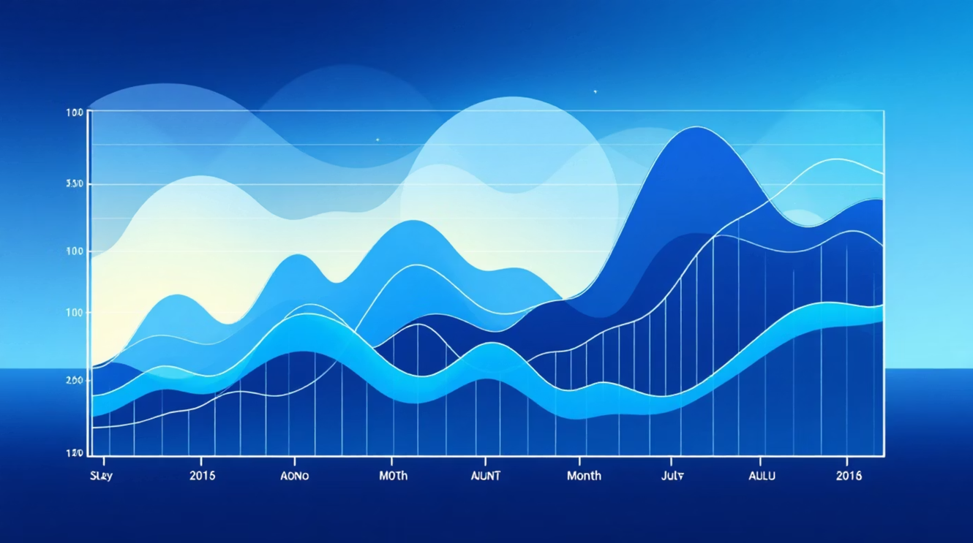
In-depth Sales & Trend Analysis
Analysing the monthly sales trend reveals critical fluctuations throughout the year, enabling proactive planning for peak and off-peak seasons.
Category-wise sales data pinpoints Electronics as a consistently strong contributor to overall revenue, underscoring its market dominance.
A deep dive into sub-category performance highlights specific product segments that are outperforming others, guiding inventory and marketing strategies.
The state-wise quantity spread exposes variations in demand across different regions, providing insights for targeted distribution and expansion efforts.
Notes:
4

Slide 5

Payment & Regional Insights for Growth
The analysis of payment methods indicates that Cash on Delivery (COD) is the most frequently used option by customers, suggesting a preference for secure post-receipt payments or a demographic that relies less on digital transactions.
Further examination reveals that certain states contribute significantly higher sales volume, acting as key markets for the business.
Conversely, areas with lower sales distribution present a considerable scope for targeted expansion and growth initiatives, leveraging localised marketing strategies or product offerings.
Notes:
5

Slide 6

Conclusion: Empowering Data-Driven Decisions
This comprehensive online sales dashboard is an invaluable tool for interactive business monitoring and strategic planning.
It enables stakeholders to quickly identify high-performing categories and regions, facilitating focused investment and resource allocation.
By providing clear, actionable insights, the dashboard supports data-driven decision-making, ultimately propelling sales growth and optimising operational efficiency.
This project demonstrates the power of Power BI in transforming raw data into strategic intelligence.
Notes:
6

